Slide 1
AllEvently Report
Benjamin Bruyns, Peggy Lewis, Spenser Morey

Slide 2
Introduction
AllEvently is a versatile website application designed to simplify event management and enhance attendee engagement by addressing common challenges in event organization. It provides tools for creating events, inviting guests, and facilitating interaction among attendees, all in one platform. Integrating features like a live chat for real-time communication and multiple invitation options—digital through the app or printed posters—AllEvently solves the problem of fragmented event planning. Hosts can efficiently manage guest responses and logistics. At the same time, attendees enjoy a seamless way to RSVP, stay updated, and connect with others involved in the event, creating a more cohesive and interactive experience.

Slide 3
Technology

Slide 4

GitHub
GitHub is a platform for storing git repositories and ensuring version control. We chose this platform because it was a requirement for the CSCI 4805 Project.

Slide 5

Vercel
Vercel is a website and database hosting platform. Vercel was chosen because it promised to be easy to upload our git repository and deploy the website continuously. We also chose it because it promised to host a relational database, which we needed to create our website.

Slide 6

PostgreSQL
PostgreSQL is a framework for databases. We chose it because we needed a relational database, and Vercel offered hosting for Postgres Database.

Slide 7

Vue.js
Vue.js is a framework for creating HTML for the user interface. We chose it because it advertised as an easy framework to use and implement.

Slide 8

Node.js
Node.js is a framework for creating the backend functionality of a website. We chose it because it is an easy framework to use and implement.

Slide 9
Database Design

Slide 10
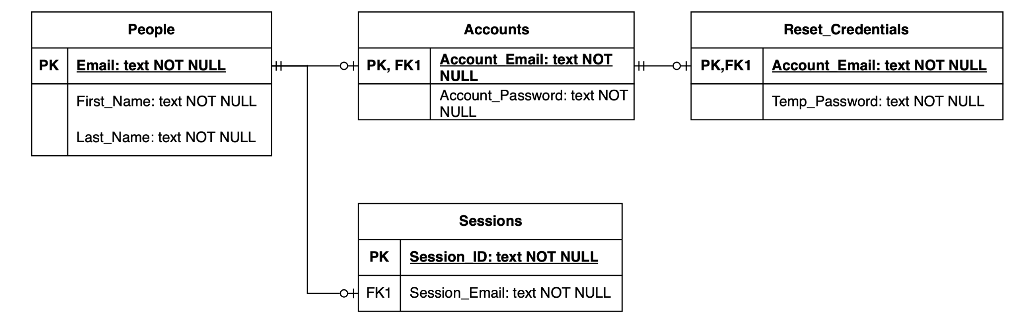
User Tables
The collective purpose of these tables is to manage user data and interactions systematically, ensuring secure access, authentication, and account management within the website.

Slide 11
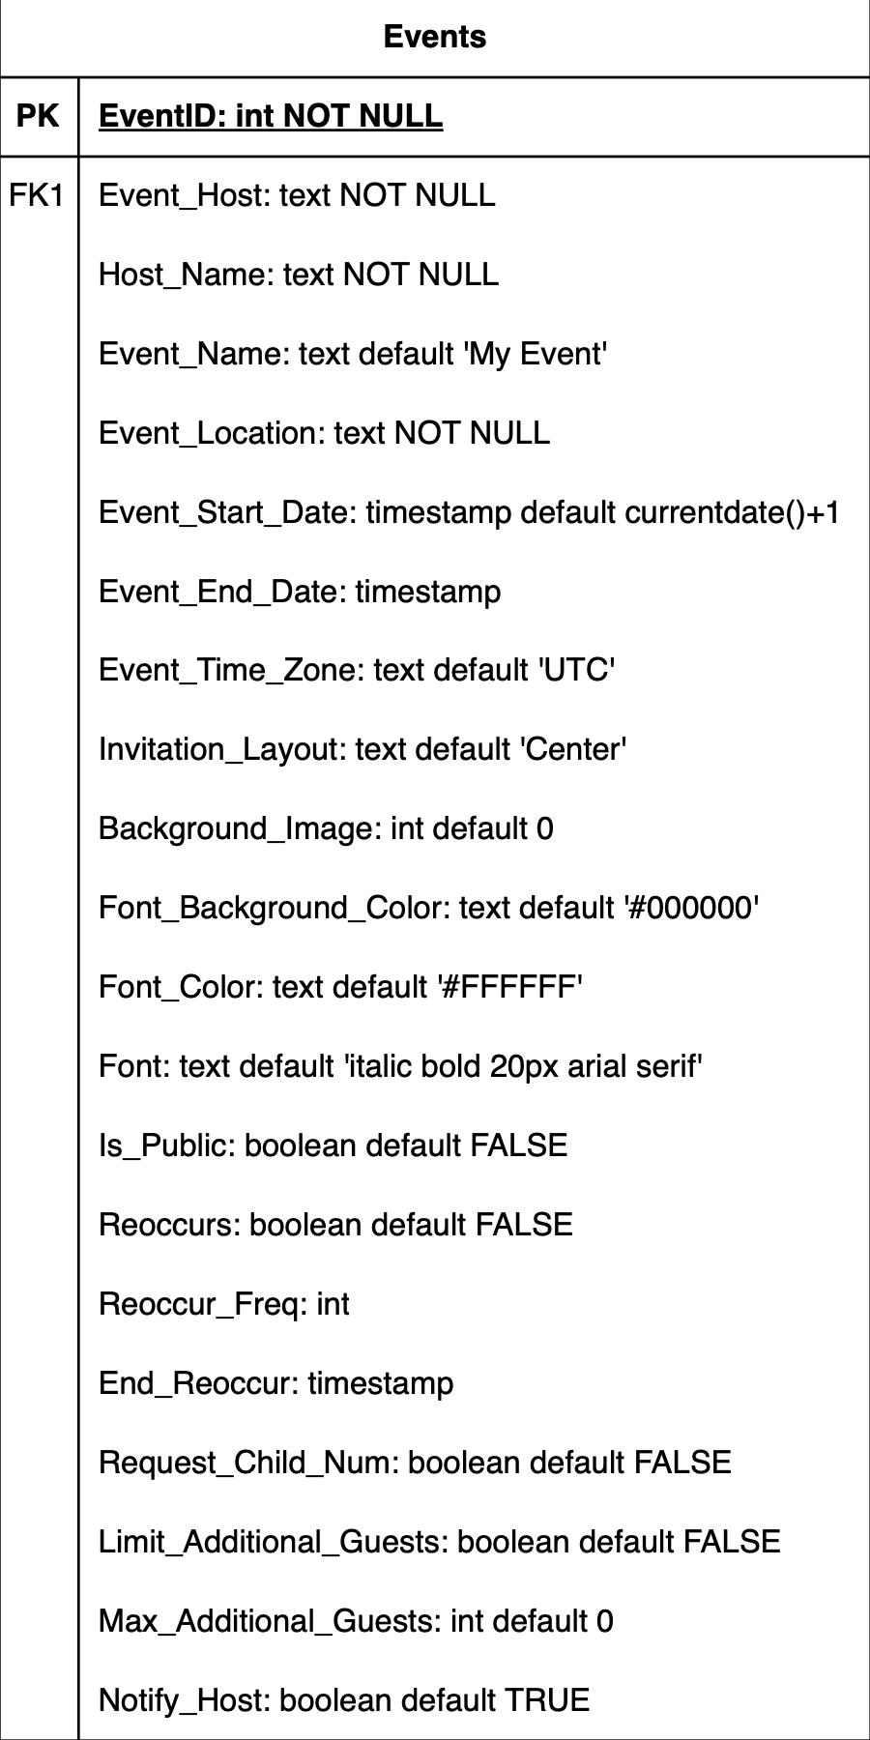
Events
This table keeps track of all events that have been created.
The foreign key references the People table.

Slide 12
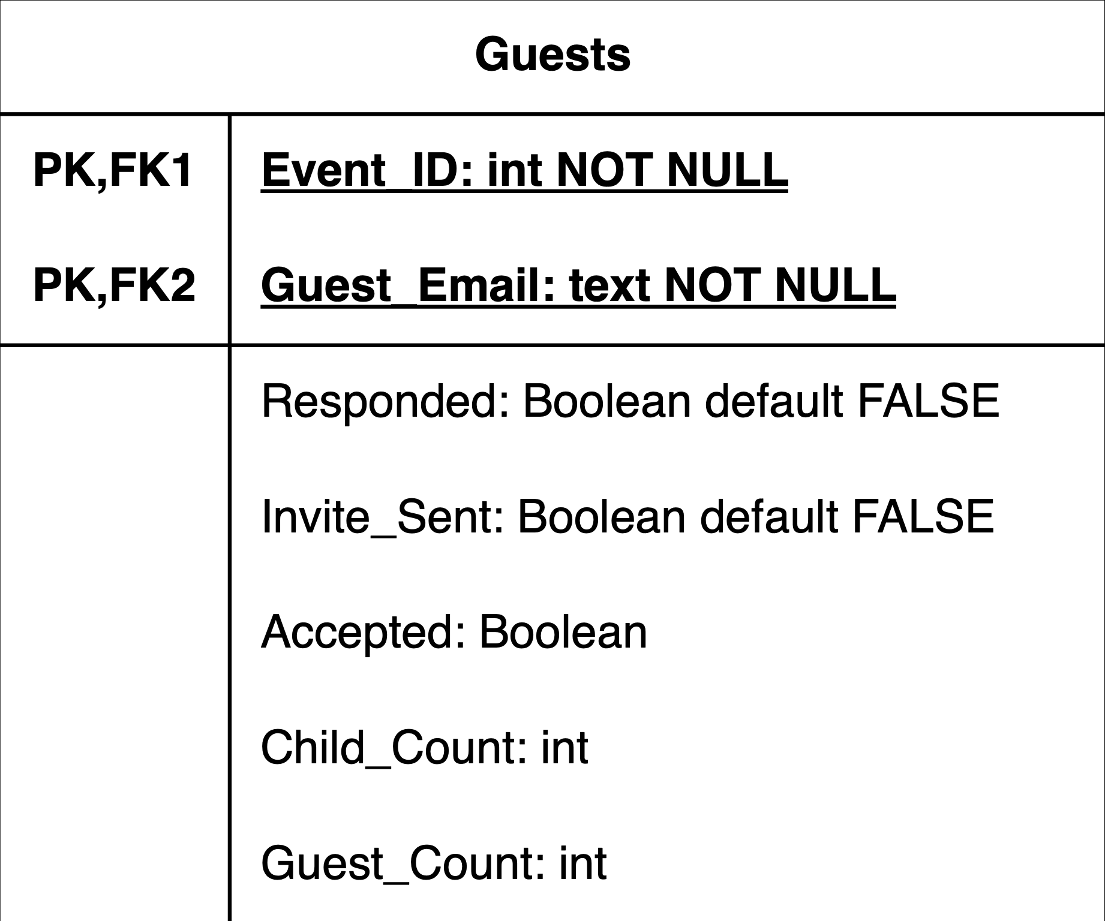
Guests
This table keeps track of messages sent by users in each events.

Slide 13
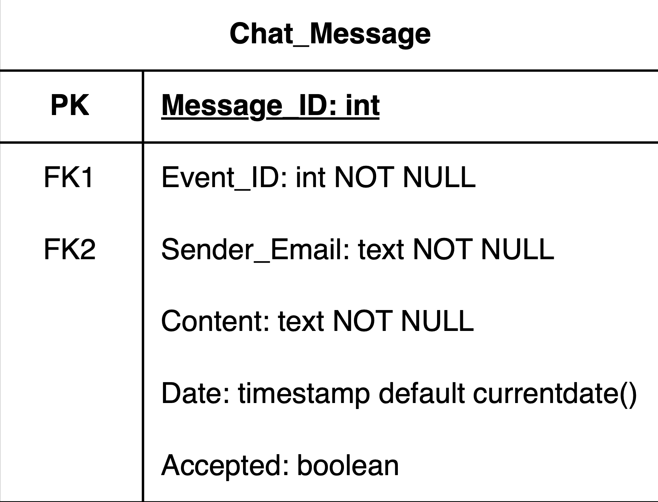
Chat Messages
This table stores information about individuals who have signed into the website and those invited to events

Slide 14
Frontend Design

Slide 15
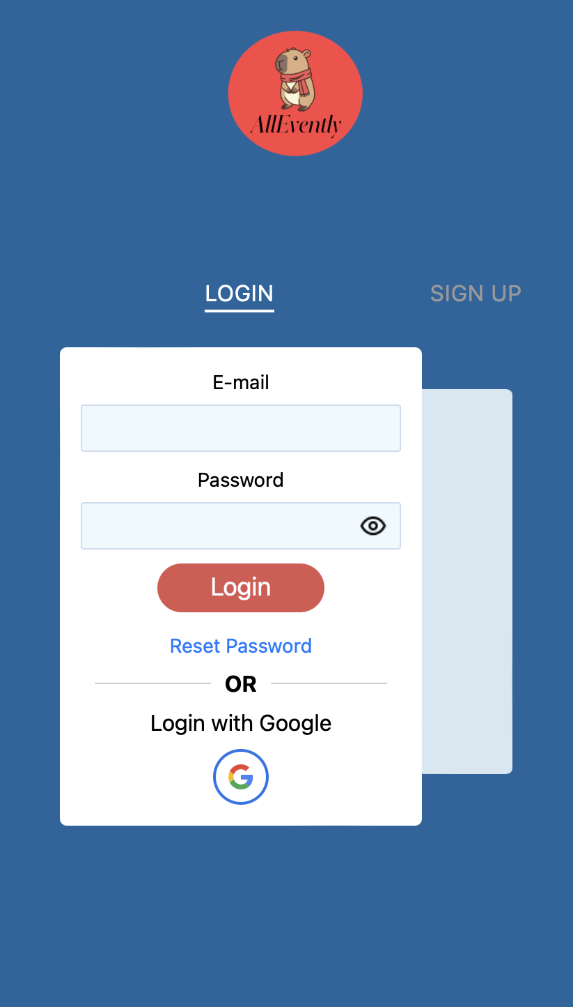
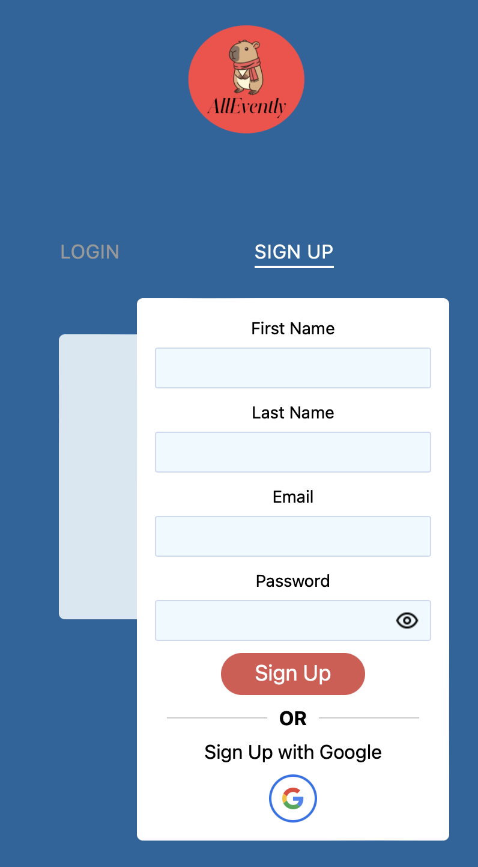
Login/Signup
This page that shows the user a login and a sign-in dialogue you can switch between. Both login and sign-in have access to the GoogleSSO.vue display, allowing the user to use Google Single-Sign-On to access our website.

Slide 16
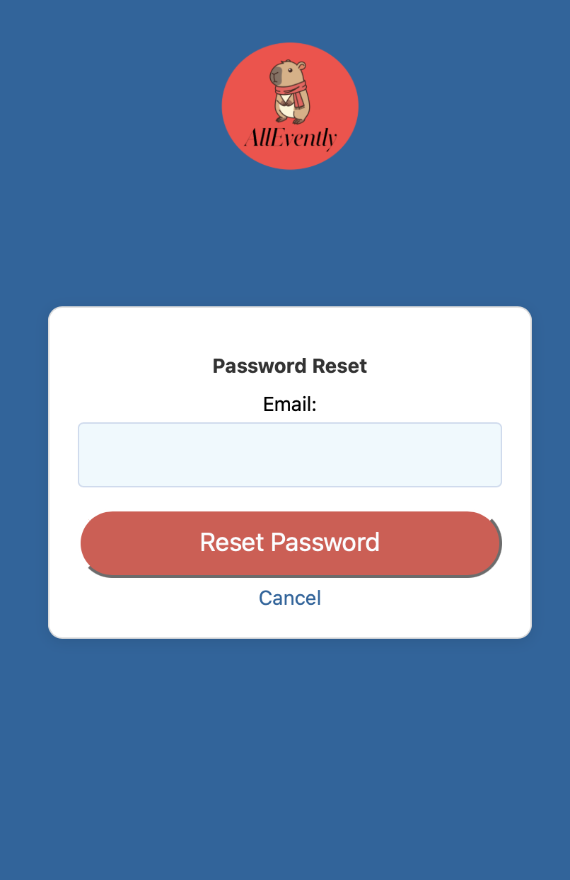
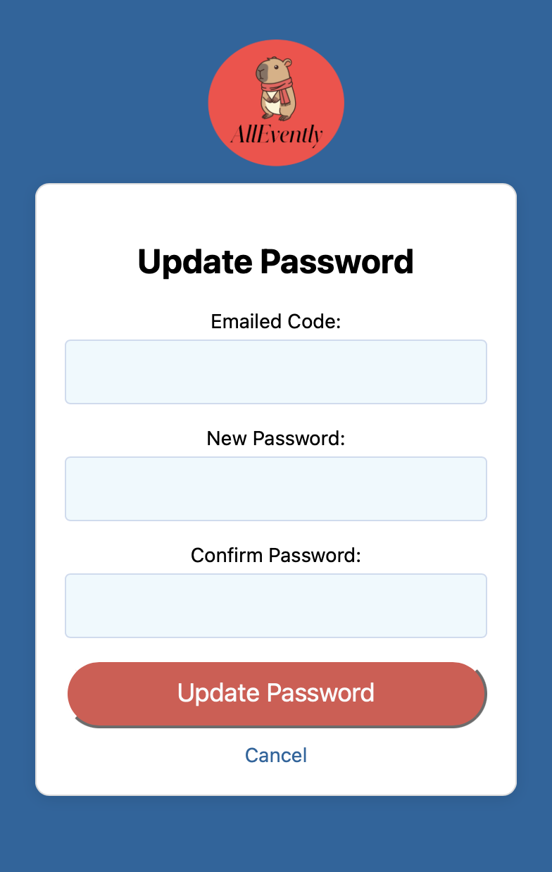
Password Changing
The Password Reset page is for sending the reset code to the user.
The Password update page allows a user to change the password using the code.

Slide 17
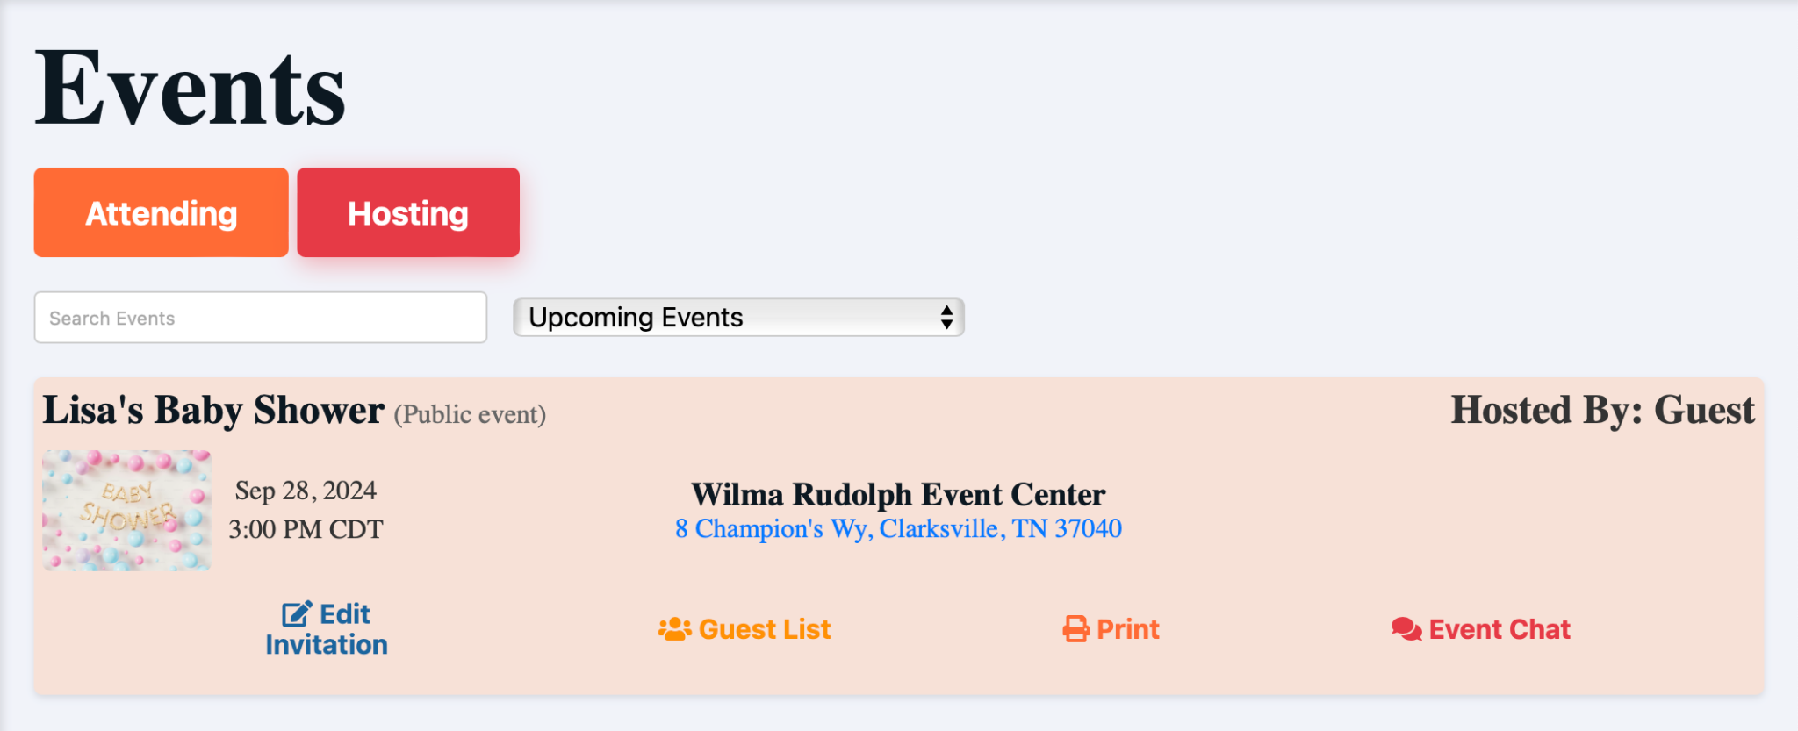
Events
A page that shows users all events they attend as EventCard.vue displays

Slide 18
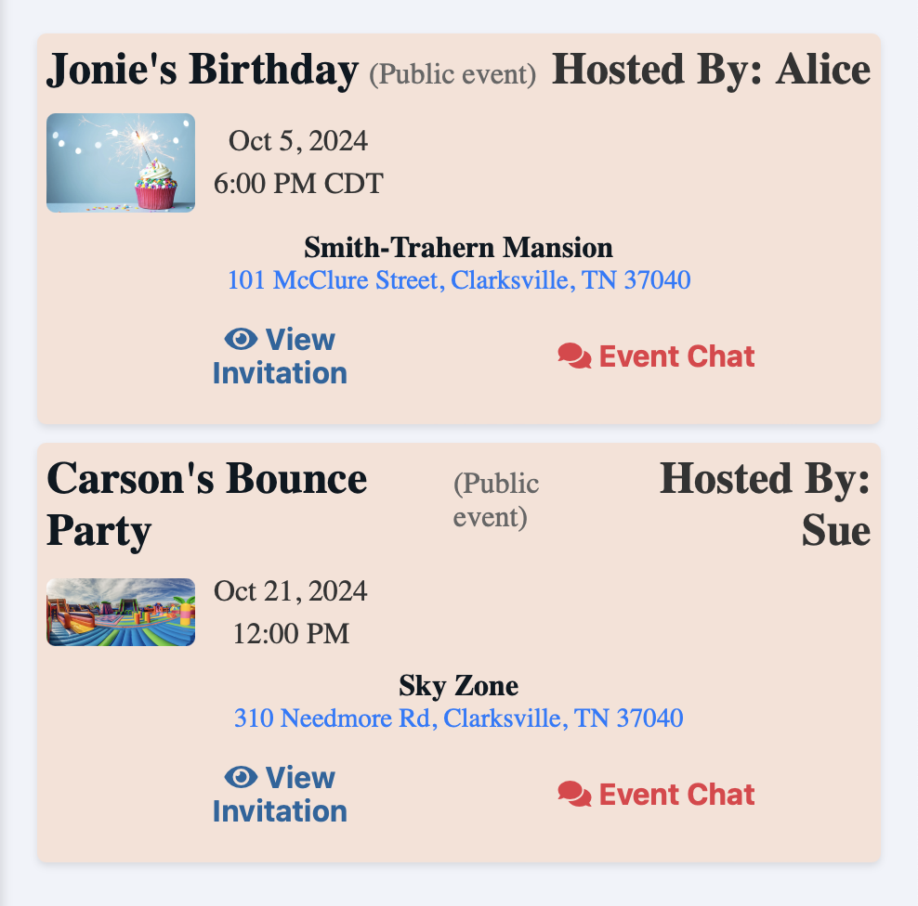
Public Events
A page that shows users all public events on PublicEventCard.vue displays

Slide 19
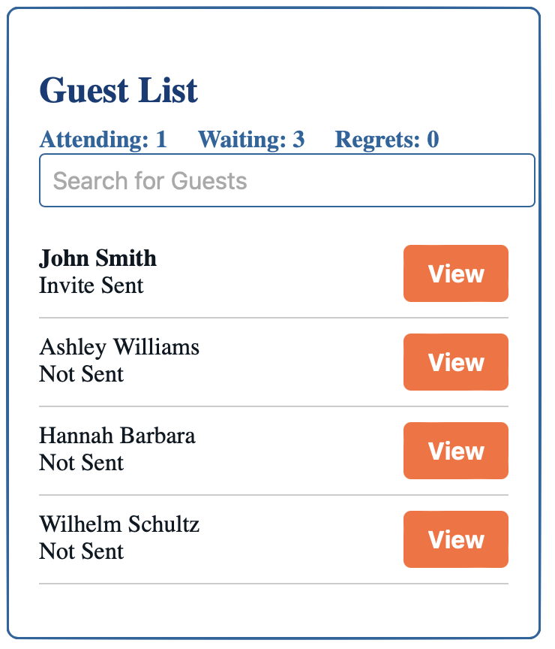
Guest List
A page that shows event hosts the RSVP status of all invitees.

Slide 20
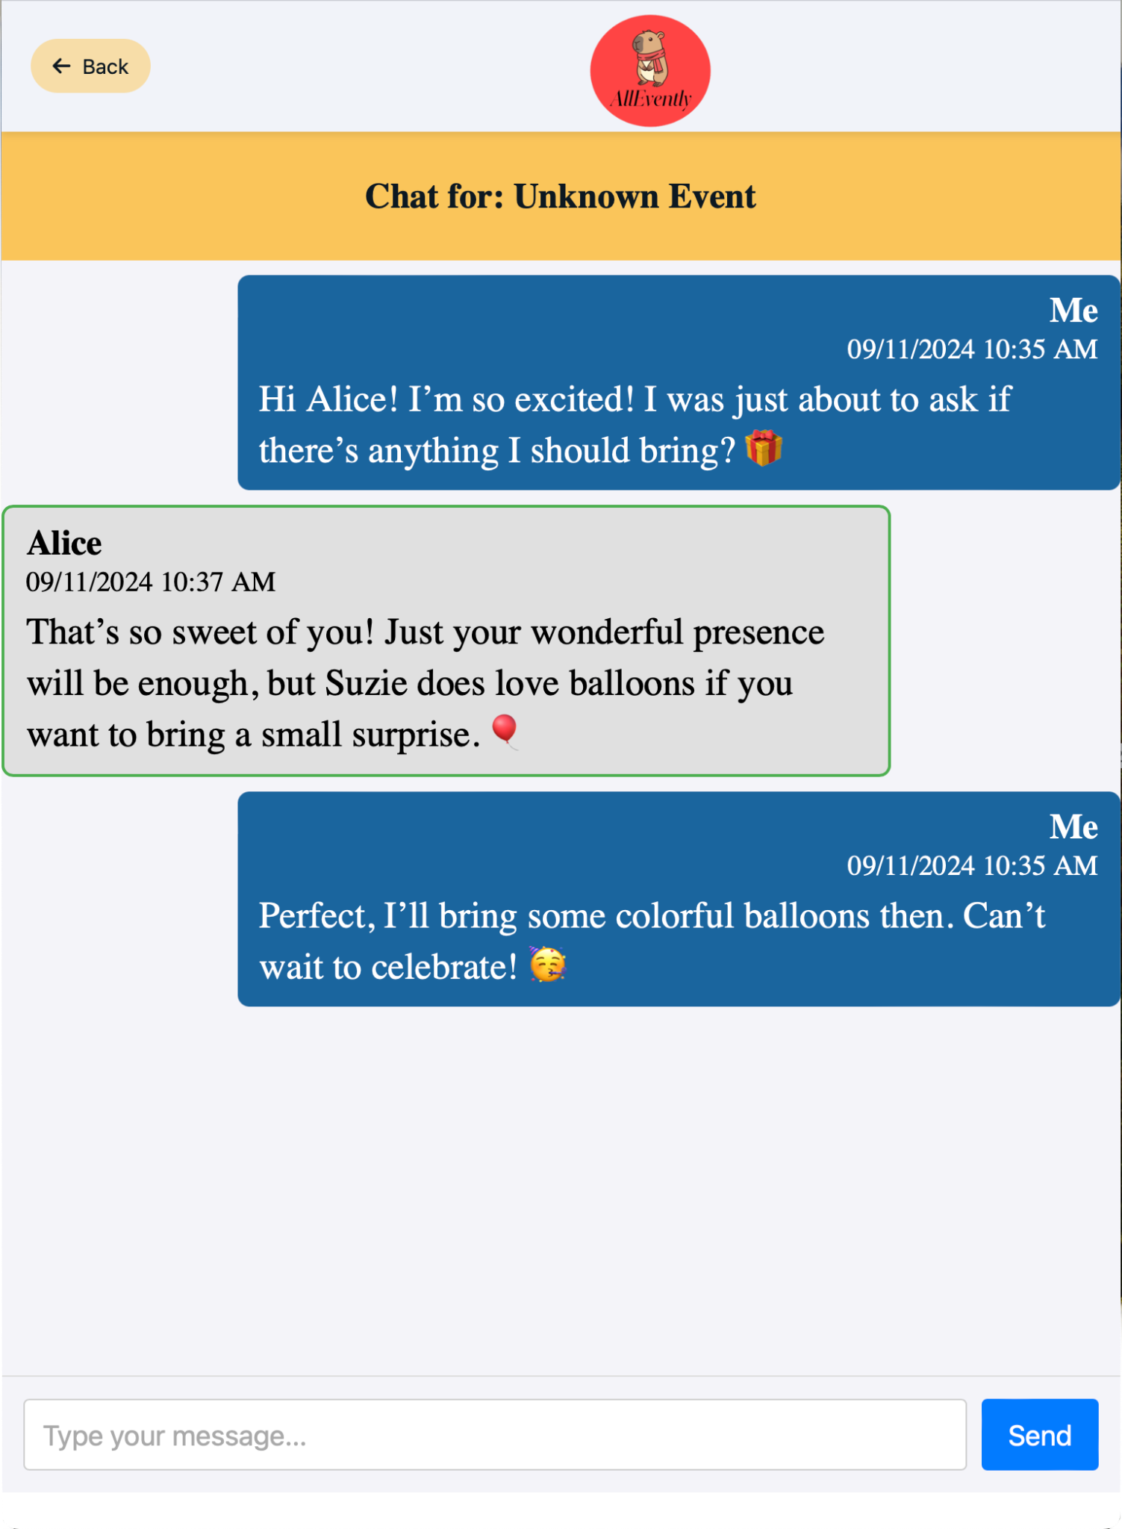
Chat
A page that shows users the messages sent in a given event.

Slide 21
Backend Design

Slide 22
Account Handling
The backend has two functions for managing user information in the database.
signup.ts for creating user accounts.
authentication.ts for checking login credentials.
currentuser.ts for fetching information of the current user is.

Slide 23
Event Management
The backend has 3 functions for managing events from the database.
attendingevents.ts for fetching events you have been invited to or have RSVPed.
hostedevents.ts for fetching events that you are hosting.
publicevents.ts for fetching events that are public.
eventcreation.ts for creating new events.

Slide 24
Vercel Deploy/Build Instructions

Slide 25
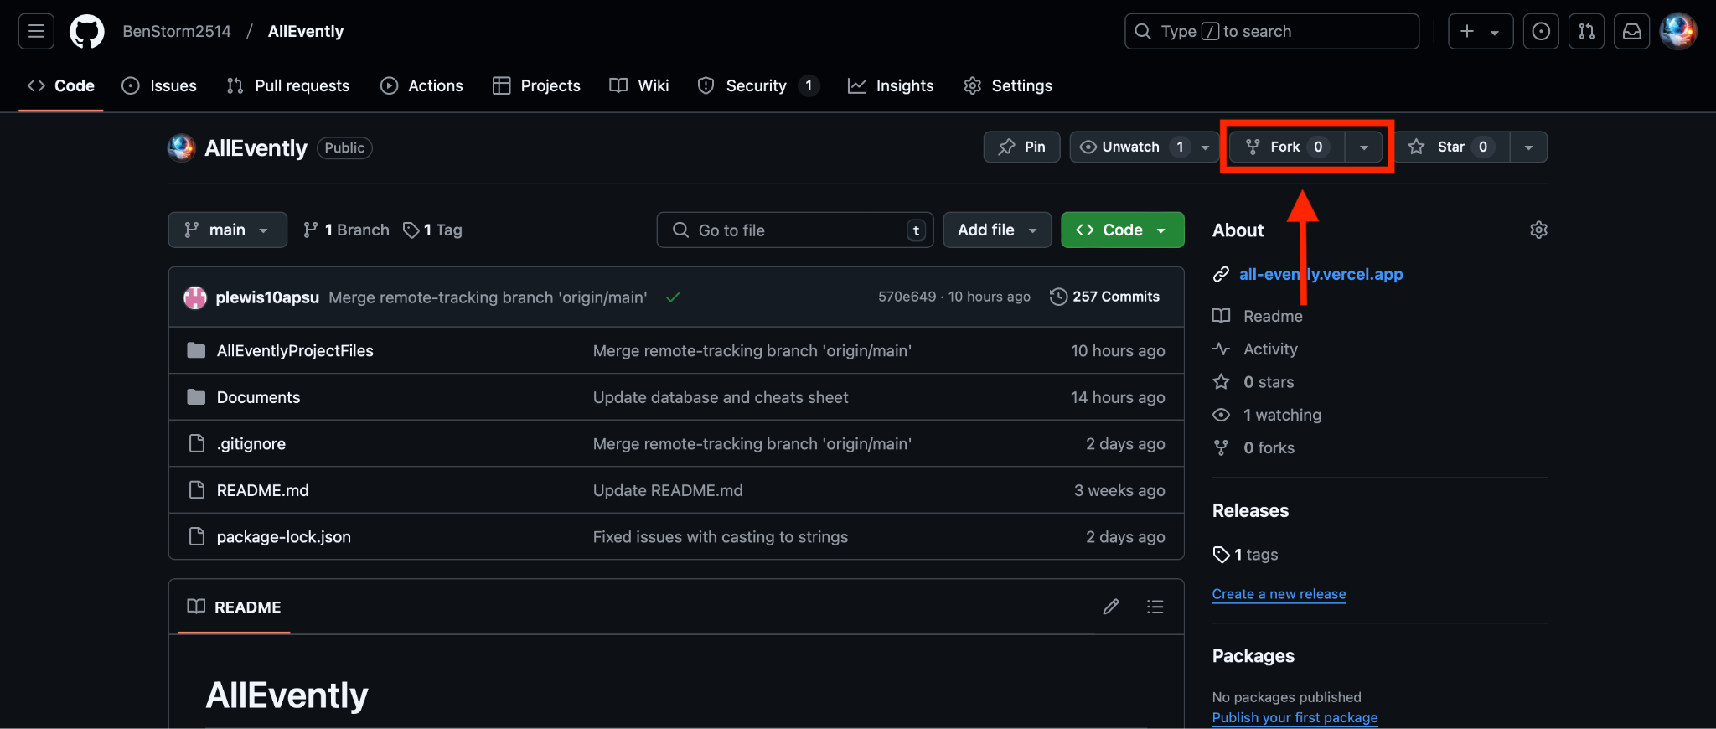
Fork Git Repo
Go to https://github.com/BenStorm2514/AllEvently

Slide 26
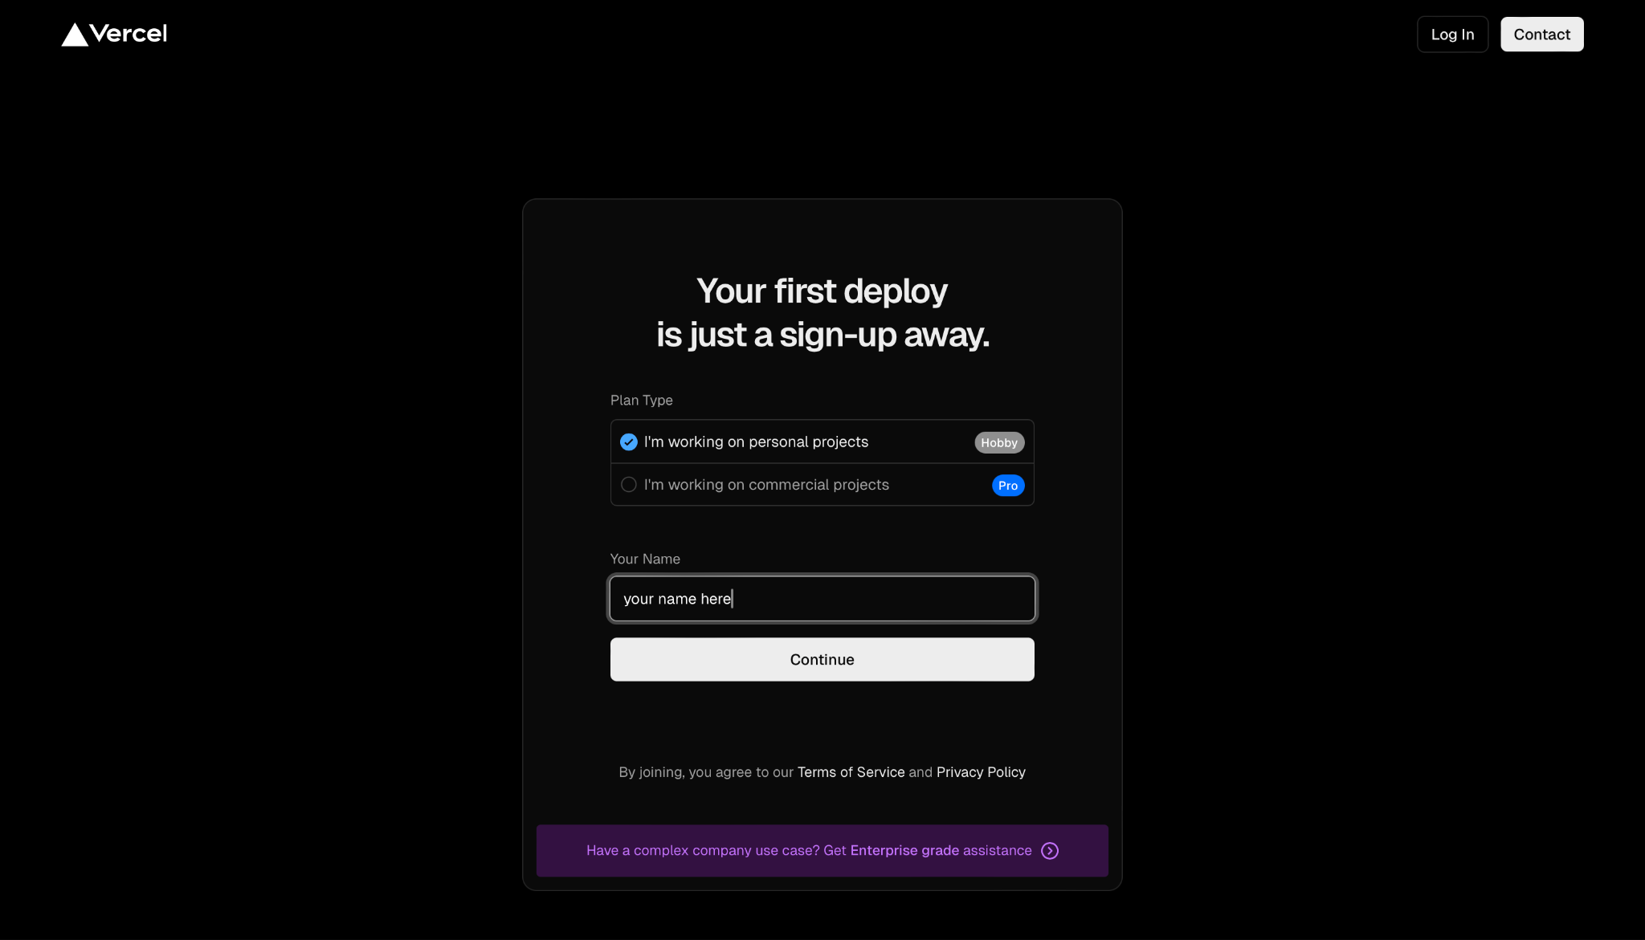
Create Vercel Account

Slide 27
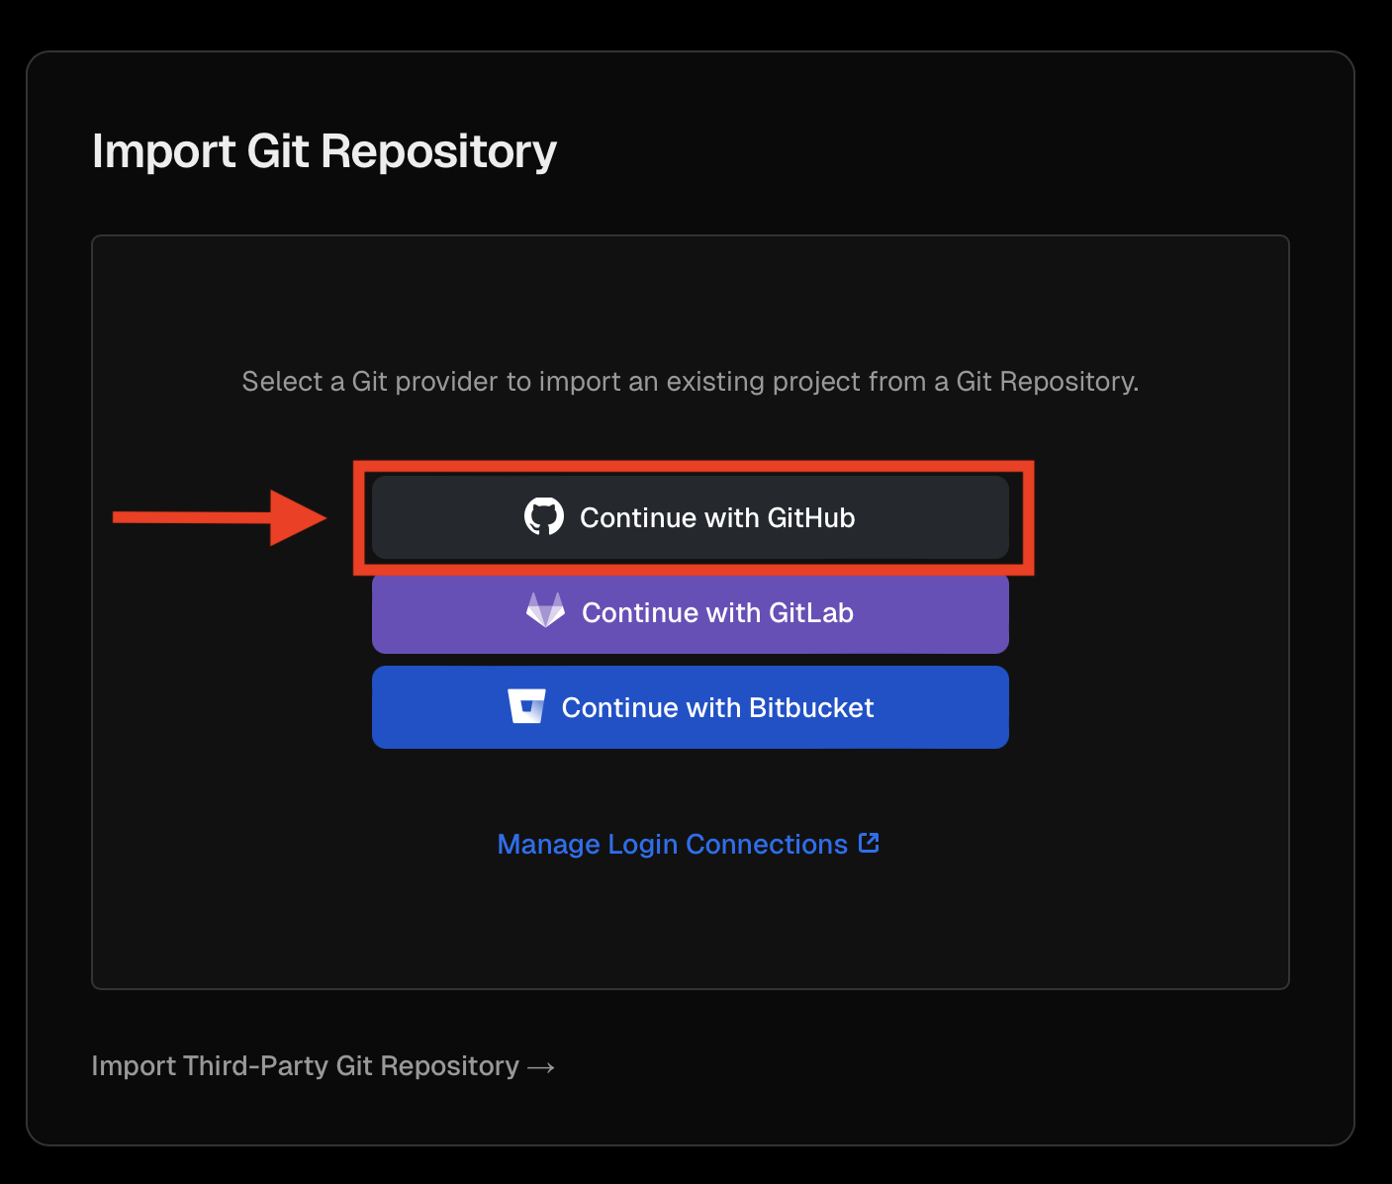
Create Vercel Project
After continuing with GitHub.
Choose to connect to your Github Account and connect to your AllEvently fork.

Slide 28
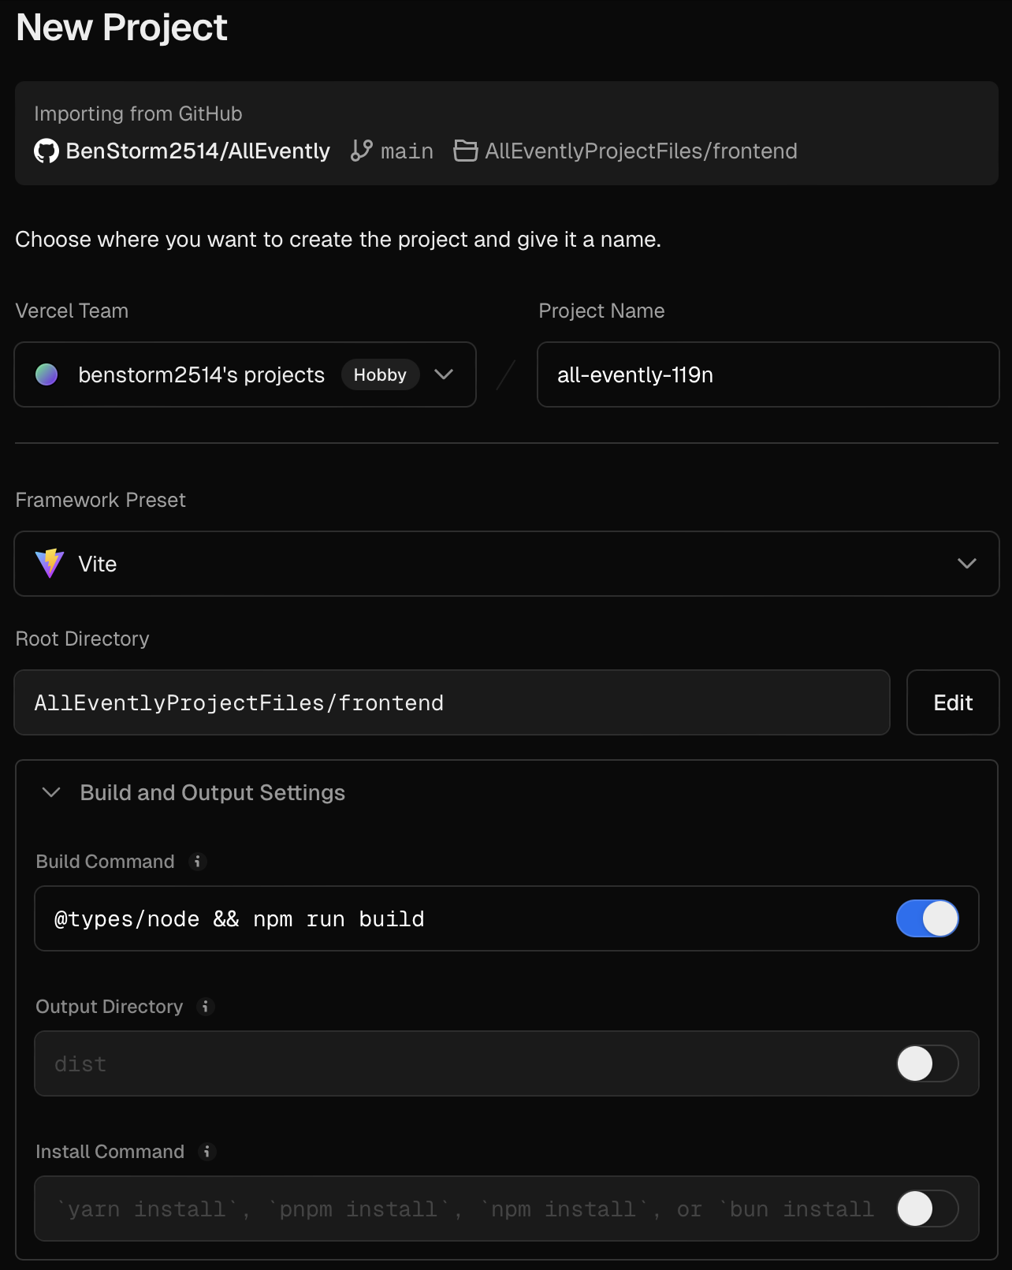
Set Deployment parameters
Make sure that you set the deployment parameters as shown in the red boxes.

Slide 29
Google Maps API
Go to the Google Cloud Console and log in with your Google account. Create a new project by clicking the project dropdown at the top and selecting New Project. Name the project, like "AllEvently Project," and create it. Once the project is created, go to APIs & Services > Library in the left sidebar and enable the Maps JavaScript API, Places API, and Static Maps API. After enabling the APIs, go to APIs & Services > Credentials and click Create Credentials > API Key. Copy the generated API key and edit it to restrict its usage. Under Application Restrictions, choose HTTP Referrers (websites) and add http://localhost/* for local development and https://your-vercel-domain.vercel.app/* for production. Also, restrict the key to the APIs enabled earlier and save the changes.

Slide 30
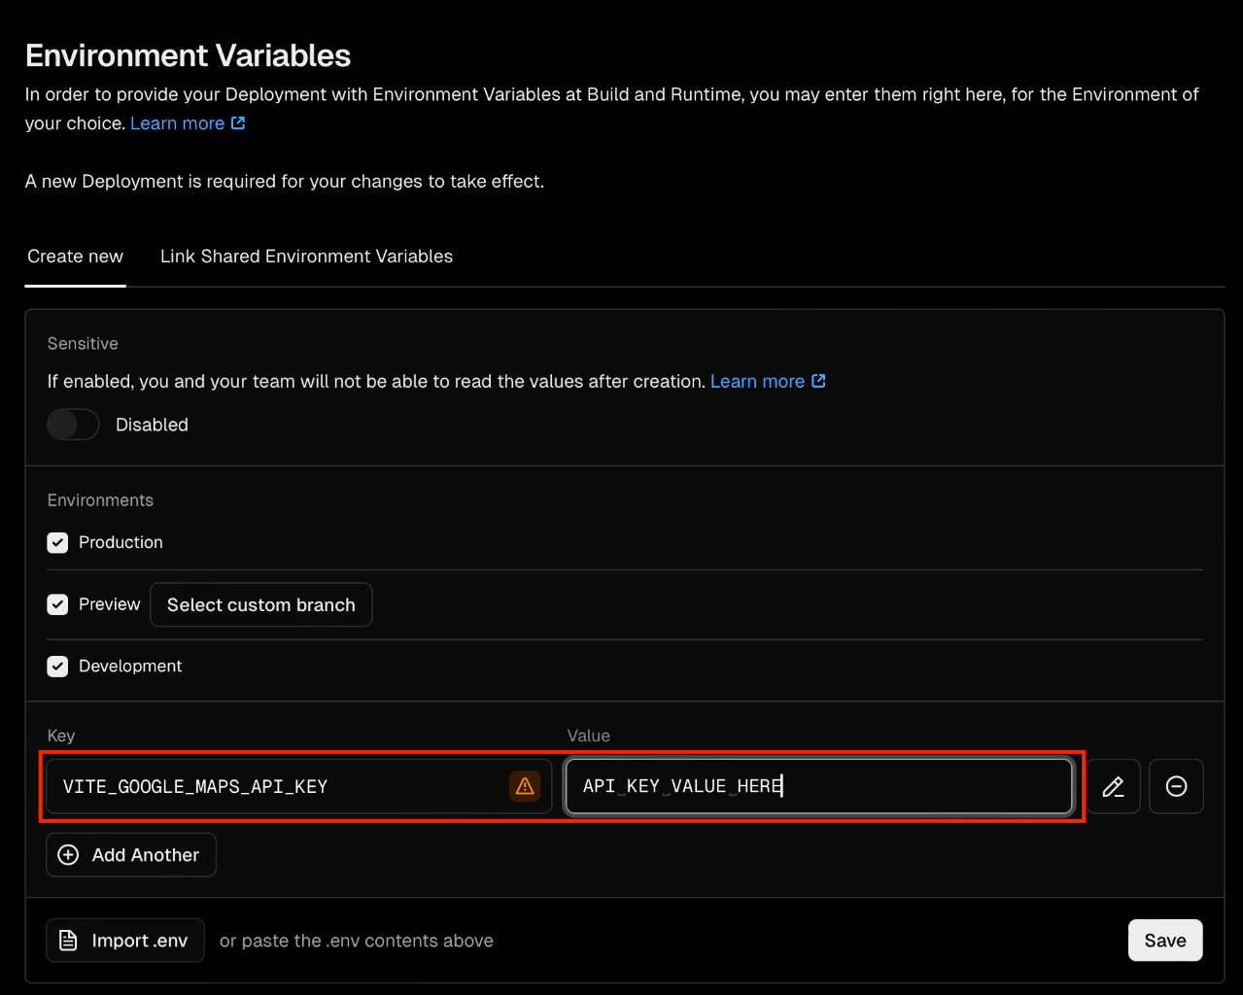
Add Google API Key
After continuing with GitHub.
Choose to connect to your Github Account and connect to your AllEvently fork.

Slide 31
Add Google API Key
Go back to your Vercel project and go to Settings > Environment variables and make a new Key.
Make sure to save.

Slide 32
Database Deploy/Build Instructions

Slide 33
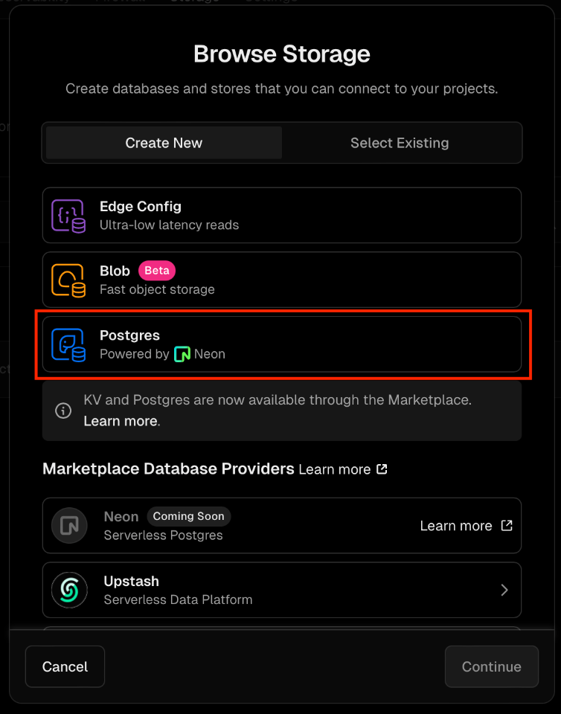
Create Vercel Database
Go to the Storage tab in your project and press Create Database.
Select Postgres.

Slide 34
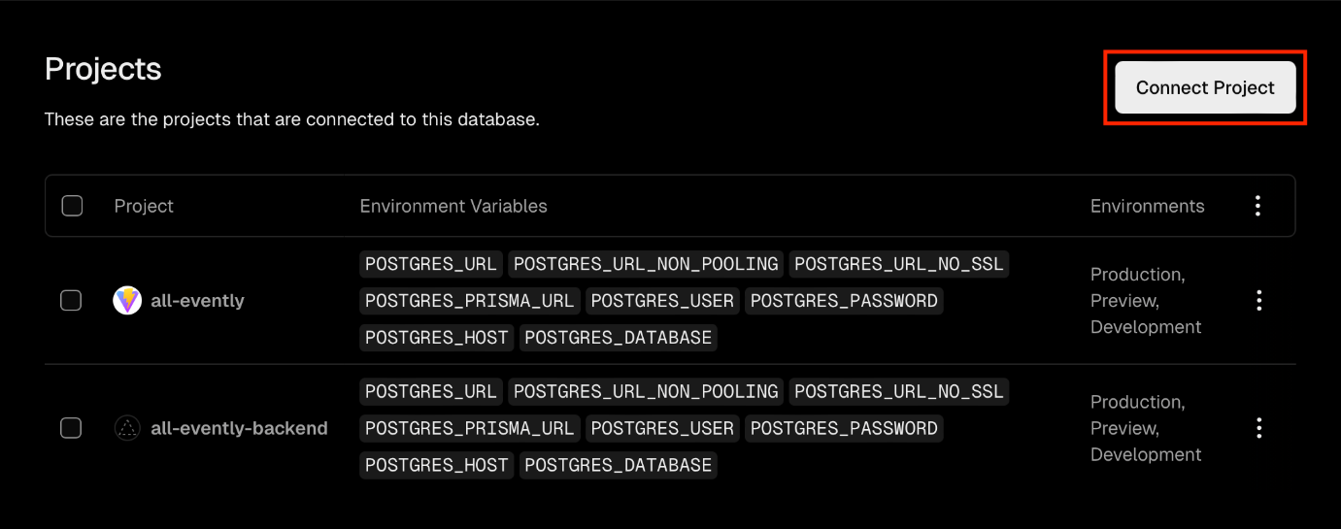
Connect Vercel Database
Go to the project tab in the database and press connect project and select your project.

Slide 35
Create Database Functionality
Next, go to the file git repo and go to Documents->Database->AllEventlyDB.sql. Copy the contents of this file and go back to the Vercel database. Go to the query tab, paste the SQL code into the prompt, and run the query.

Slide 36
Thank You!

